Slide 1


Slide 2
 | TEAM MEMBERS
1 | S. GANESH KUMAR
2 | B. HARIPRASATH
3 | S. HARIKRISHNAN
4 | B. HEMANTH SURIYA
5 | ILAIYARAJA .R
Project titel:
Cloud-Hosted-Banking-Solutions
NM ID:NM2024TMID14716

Slide 3



Cloud-Hosted Banking Solutions
Explore how cloud-hosted banking analytics can transform your institution with secure, scalable, and cost-effective data insights. This presentation will guide you through the architecture, key benefits, and AWS services for your banking data needs.
Notes:
<number>

Slide 4

The Scenario
1
Modernize Banking Analytics
2
Leverage the Cloud
You want to explore how cloud-hosted solutions can provide greater scalability, security, and cost-savings compared to on-premises infrastructure.
Your bank is looking to upgrade its data analytics capabilities to drive better customer experiences and operational efficiency.
Notes:
<number>

Slide 5
Cloud-Hosted Architecture
Secure Data Lake
Scalable Analytics
Interactive Dashboards
Integrated Ecosystem
Ingest and store banking data securely in an Amazon S3 data lake.
Analyze data at scale using Amazon Athena and Amazon Redshift for fast, flexible querying.
Build interactive, self-service dashboards with Amazon QuickSight.
Leverage the full suite of AWS services for a seamless, end-to-end analytics solution.
Notes:
<number>

Slide 6

Prior Knowledge
Data Sources
Analytics Requirements
Cloud Familiarity
Understanding your bank's key data sources, such as customer transactions, account information, and market data.
Some familiarity with cloud computing concepts and AWS services for data and analytics.
Defining the specific analytical needs of your bank, such as customer segmentation, fraud detection, and risk management.
Notes:
<number>

Slide 7

AWS Account Creation
Sign Up
1
Create an AWS account by visiting the AWS website and providing the necessary information.
Verify Identity
2
Confirm your identity and billing information to activate your new AWS account.
Explore Console
3
Navigate the AWS Management Console to familiarize yourself with the available services and features.
Notes:
<number>

Slide 8
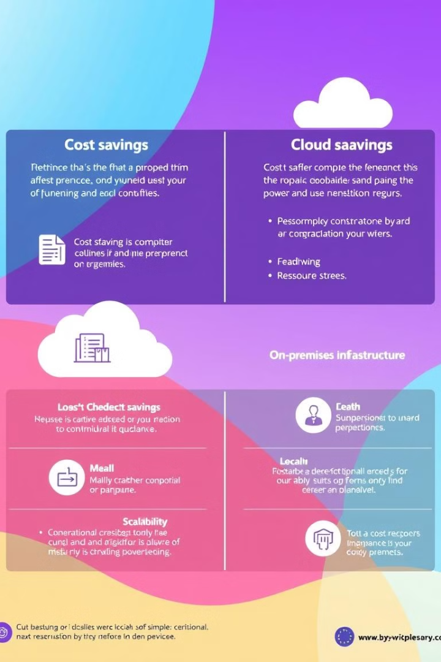



Key Benefits of Cloud-Hosted Analytics
Cost Savings
Scalability
Eliminate the need for expensive on-premises hardware and IT infrastructure.
Easily scale computing resources up or down to meet changing business demands.
Security
Flexibility
Leverage AWS's robust security and compliance features to protect sensitive banking data.
Quickly adapt to market changes and new business requirements with agile cloud services.
Notes:
<number>

Slide 9
AWS Services for Banking Analytics
Amazon S3
Amazon Athena
Amazon Redshift
Amazon QuickSight
Secure, scalable object storage for your banking data lake.
Serverless, interactive query service to analyze data in S3 using standard SQL.
Fast, scalable data warehousing service for complex analytical queries.
Business intelligence and data visualization service for interactive dashboards.
Notes:
<number>

Slide 10

Conclusion
Modernize Banking Analytics
Leverage AWS Services
Utilize the full suite of AWS analytics services for a secure, scalable, and cost-effective data platform.
Cloud-hosted solutions can transform your bank's data capabilities, driving better insights and experiences.
Ready to get started? Let's discuss how cloud-hosted banking analytics can benefit your institution.
Notes:
<number>

